Slide 1
Introduction to Programming
Peggy Batchelor

Slide 2
Module 1
Programming Concepts

Slide 7
Defining terms
A program is a description in a programming language of a process that achieves some result.
An algorithm is a description of a process in a step-by-step manner.
The same algorithm could be written in many languages.

Slide 11
What computers understand
Computers are exceedingly stupid
The only data they understand is 0’s and 1’s
They can only do the most simple things with those 0’s and 1’s
Move this value here
Add, multiply, subtract, divide these values
Compare these values, and if one is less than the other, go follow this step rather than that one.
Done fast enough, those simple things can be amazing.

Slide 12
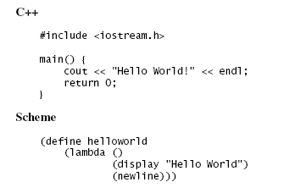
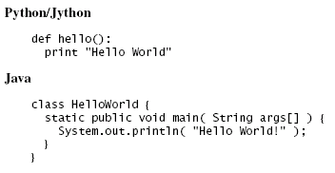
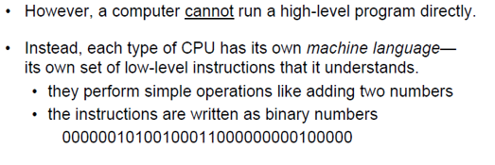
Programming Languages
Different programming languages are different ways (encodings) that turn into (same/similar) commands for the computer

Slide 13
Python
The programming language we will be using is called Python
http://www.python.org
Python is a popular programing language, which is designed to be easy to read.
Used by many companies.
It’s used by companies like Google, Industrial Light & Magic, Pixar, Nextel, and others
Also used to make application software flexible and expendable.
For example, can be used to program GIMP or Blender

Slide 15
A word about Jython
Jython is Python
Python is a language implemented in C.
Jython is the same language implemented in Java.
Is the pizza different if a different company makes the flour? If so, not by much.

Slide 16
Key Concept: Encodings
We can interpret the 0’s and 1’s in computer memory any way we want.
We can treat them as numbers.
We can encode information in those numbers
Even the notion that the computer understands numbers is an interpretation
We encode the voltages on wires as 0’s and 1’s, eight of these defining a byte
Which we can, in turn, interpret as a decimal number

Slide 17
Computation for Communication
All media are going digital
Digital media are manipulated with software
You are limited in your communication by what your software allows
What if you want to say something that Microsoft or Adobe or Apple doesn’t let you say?

Slide 18
Programming is a communications skill
If you want to say something that your tools don’t allow, program it yourself
If you want to understand what your tools can or cannot do, you need to understand what the programs are doing
If you care about preparing media for the Web, for marketing, for print, for broadcast… then it’s worth your while to understand how the media are and can be manipulated.
Knowledge is Power, Knowing how media work is powerful and freeing

Slide 19
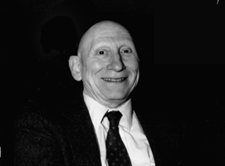
Knowing about programming is knowing about process
Alan Perlis
One of the founders of computer science
Argued in 1961 that Computer Science should be part of a liberal education: Everyone should learn to program.
Perhaps computing is more critical to a liberal education than Calculus
Calculus is about rates, and that’s important to many.
Computer science is about process, and that’s important to everyone.
Automating process changes everything.

Slide 20
Programming is about Communicating Process
A program is the most concise statement possible to communicate a process
That’s why it’s important to scientists and others who want to specify how to do something understandably in as few words as possible

Slide 27
Key Words, Operators, and Syntax: an Overview
Key words: predefined words used to write program in high-level language
Each key word has specific meaning
Operators: perform operations on data
Example: math operators to perform arithmetic
Syntax: set of rules to be followed when writing program
Statement: individual instruction used in high-level language

Slide 28
Compilers and Interpreters
Programs written in high-level languages such as Python must be translated into machine language to be executed
Compiler: translates high-level language program into separate machine language program
Machine language program can be executed at any time

Slide 29
Compilers and Interpreters (cont’d.)
Interpreter: translates and executes instructions in high-level language program
Used by Python language
Interprets one instruction at a time
No separate machine language program
Source code: statements written by programmer
Syntax error: prevents code from being translated

Slide 30
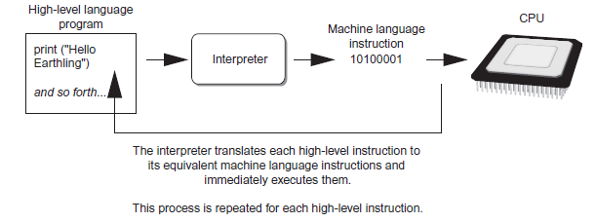
Compilers and Interpreters (cont’d.)
Figure 1-19 Executing a high-level program with an interpreter

Slide 31
Module 2
Using Python

Slide 32
Using Python
Python must be installed and configured prior to use
One of the items installed is the Python interpreter
Python interpreter can be used in two modes:
Interactive mode: enter statements on keyboard
Script mode: save statements in Python script

Slide 33
Interactive Mode
When you start Python in interactive mode, you will see a prompt
Indicates the interpreter is waiting for a Python statement to be typed
Prompt reappears after previous statement is executed
Error message displayed If you incorrectly type a statement
Good way to learn new parts of Python

Slide 34
Writing Python Programs and Running Them in Script Mode
Statements entered in interactive mode are not saved as a program
To have a program use script mode
Save a set of Python statements in a file
The filename should have the .py extension
To run the file, or script, type
python filename
at the operating system command line

Slide 35
The IDLE Programming Environment
IDLE (Integrated Development Program): single program that provides tools to write, execute and test a program
Automatically installed when Python language is installed
Runs in interactive mode
Has built-in text editor with features designed to help write Python programs

